Slide 1

AR Reconciliation

Slide 2
Automation Design Concept

Slide 3
Automation Solution
Mercari
Adyen
AMEX
Paypal
Login System and
Download data from website
Others
Website Data
Third Party Data
Upload Excel to google drive
Consolidated data
Run Marco Scrip/Database Solution
Report to the stakeholder

Slide 4
Database Solution
Website Data
Third Party Data
Database Platform
Order ID
Handel Exceptions
Database output

Slide 5
Understand the Data and Flow

Slide 6
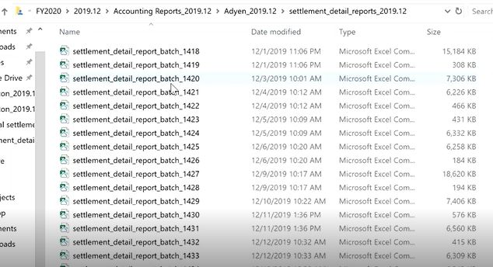
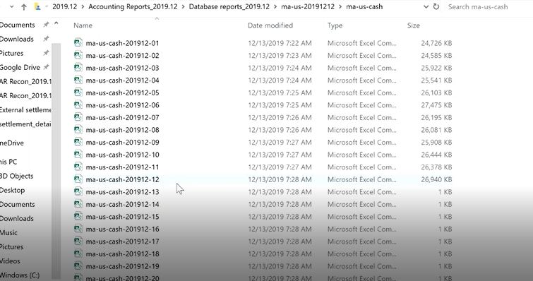
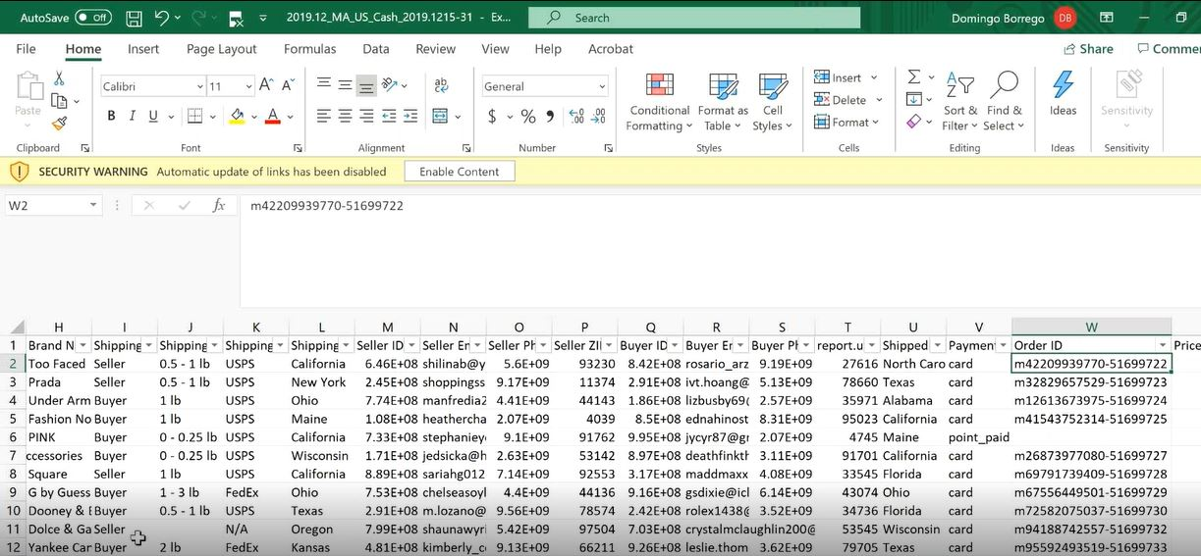
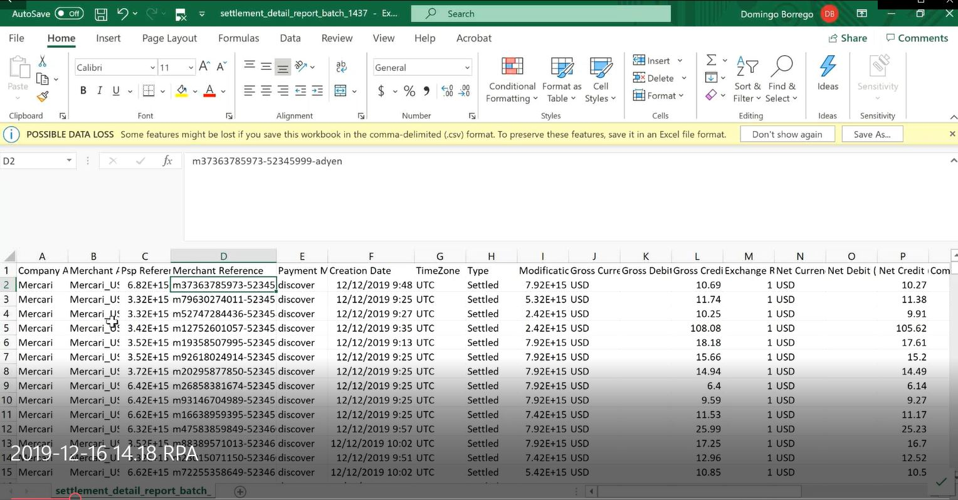
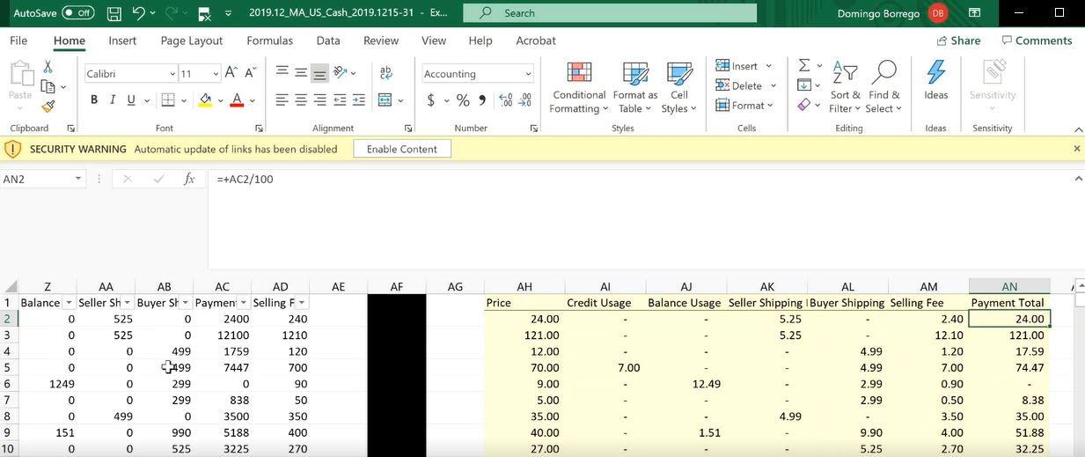
Database report (Ecommerce website)
Agent report (3rd party vender – Adyen/AMEX/Paypal)
Order ID(Joint)
Order ID=Transaction ID + Item ID
Settle detail report_batch
Source reports
(Download everyday)
Consolidated
Data
AR Reconciliation
Report
Combined Report
Data cleaning

Slide 7
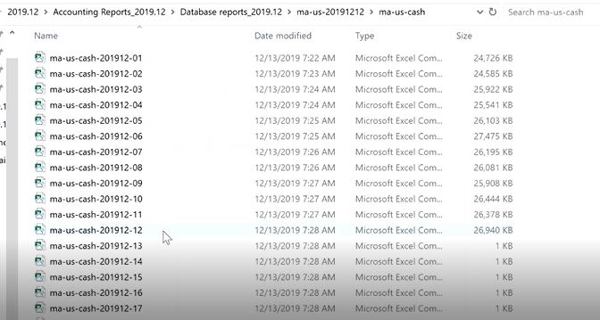
Database report (Ecommerce website)

Slide 8
Agent report (3rd party vender – Adyen/AMEX/Paypal)

Slide 9
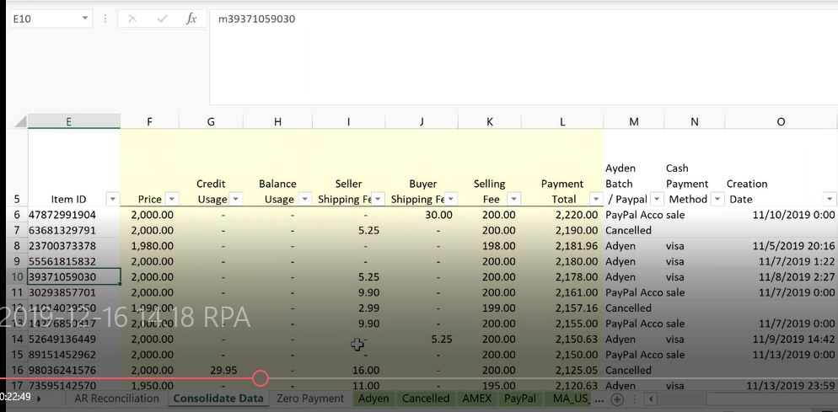
Consolidated Data

Slide 10
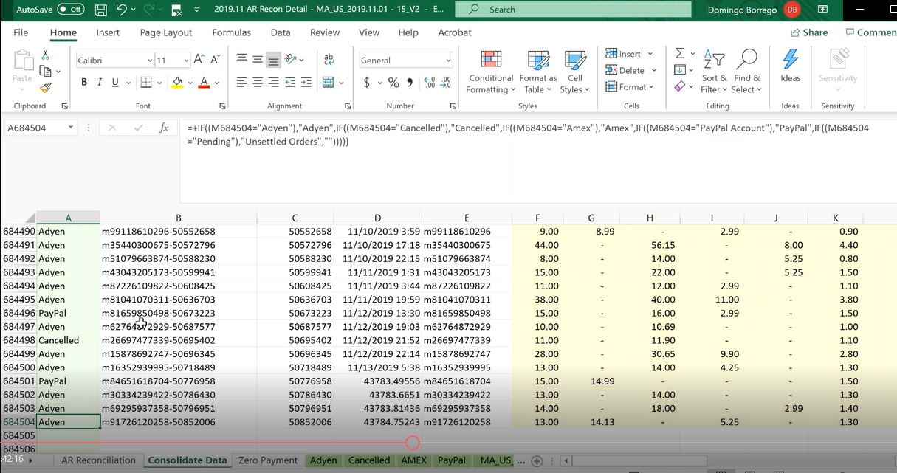
Vender Name – Column A

Slide 11
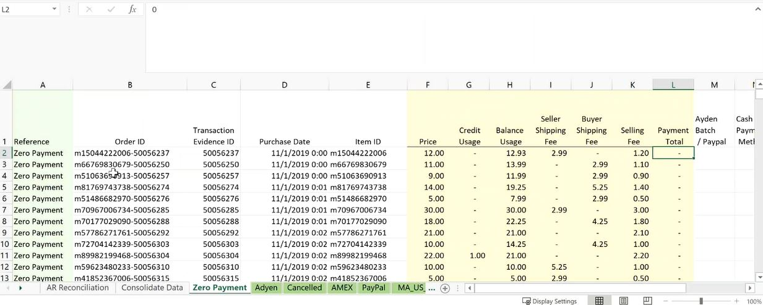
Vender Payment Total – Column L

Slide 12
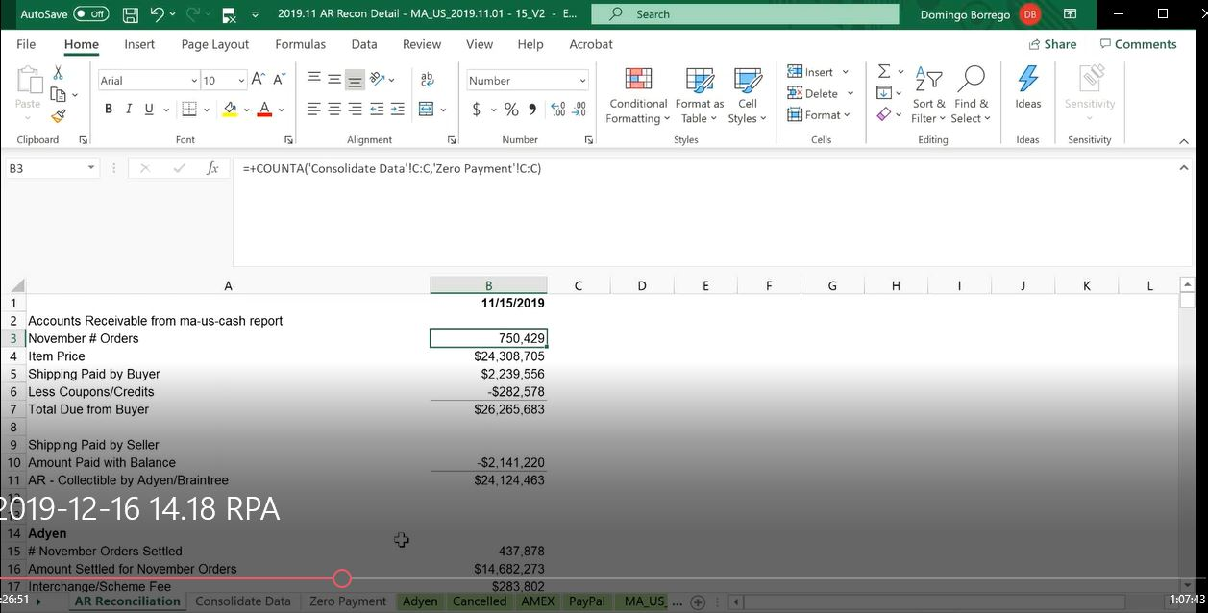

Slide 13
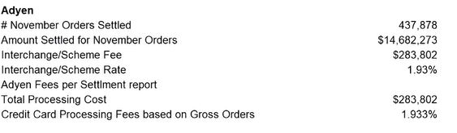
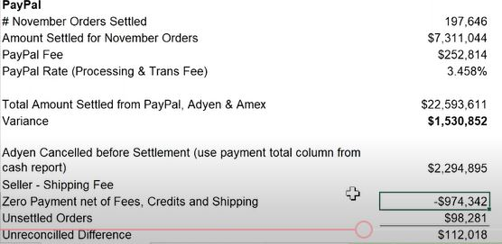
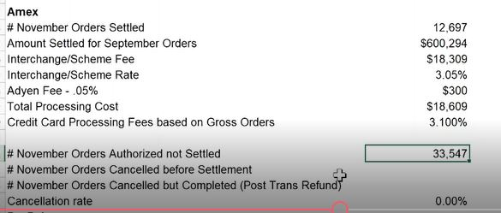

Slide 14
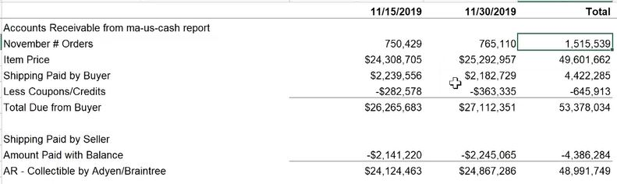
Final AR Reconciliation Report

Slide 15
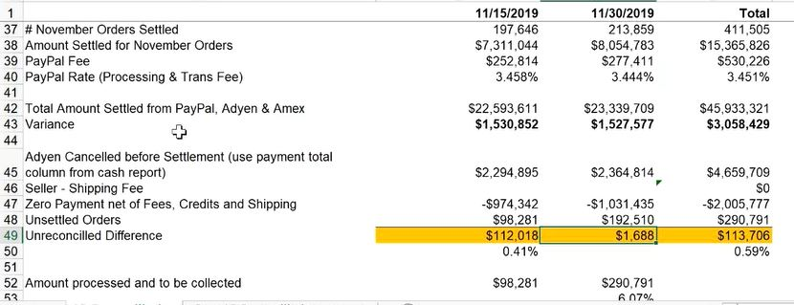
Download due to
Time zone difference

